Slide 1



Welcome

Slide 2
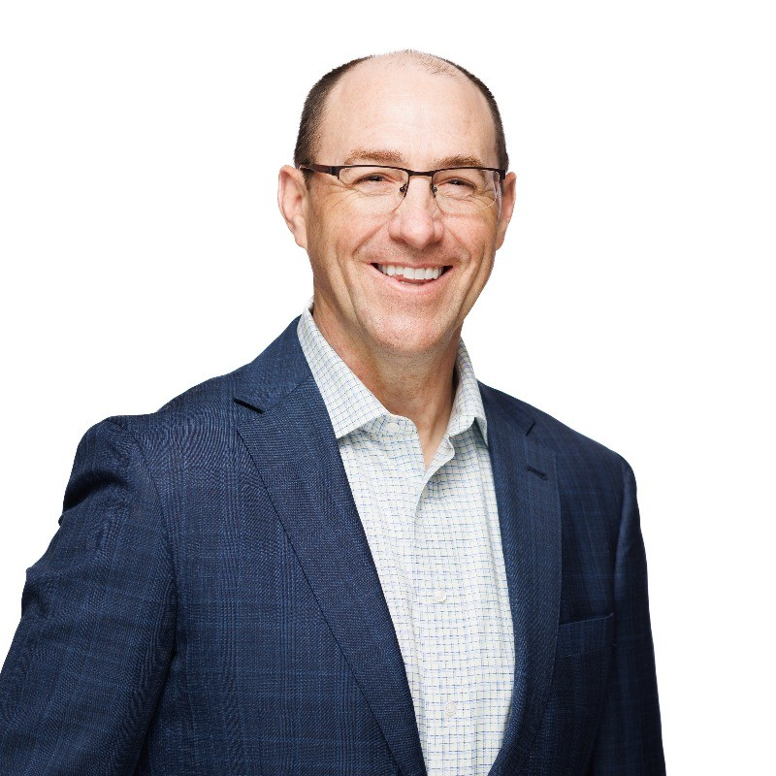
The Power of Advocacy!
Tom Leary, CAE, FHIMSS
SVP & Head of GR

Slide 3





Vision
Mission
To realize the full health
potential of every human, everywhere.
Reform the global health ecosystem through the power of information and technology.

Slide 4
Health Equity
Recurring Themes
Population and Public Health
Workforce Development
Interoperability
Connected
Health
Cybersecurity, Data Privacy
Artificial Intelligence
Policy Pillars
Make Communities Healthier
Increase Economic Opportunity
Expand Access to High Quality Care
Foundational Values
Support Global Health Transformation

Slide 5

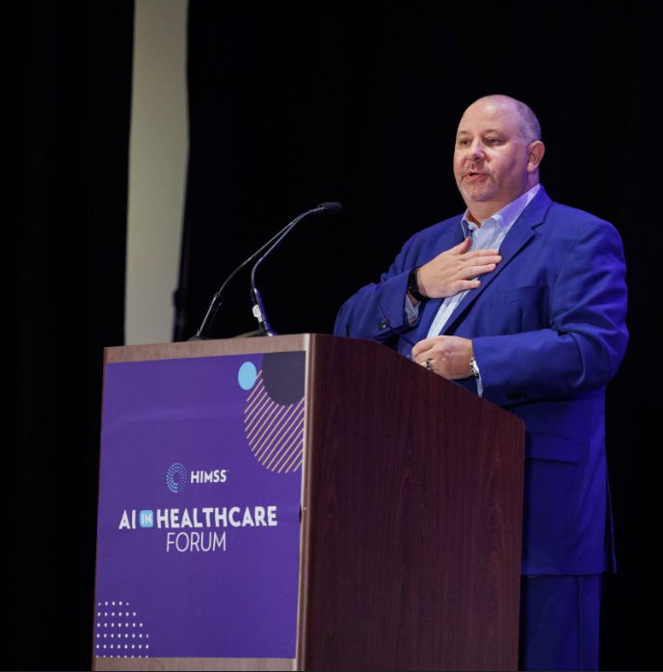
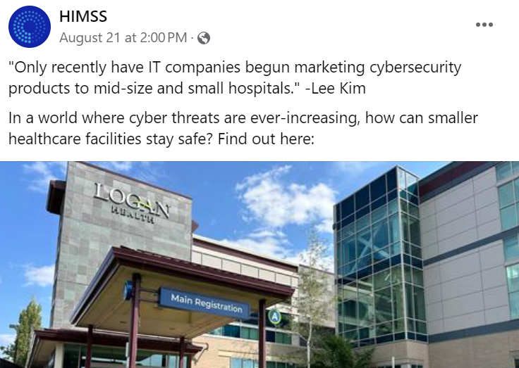
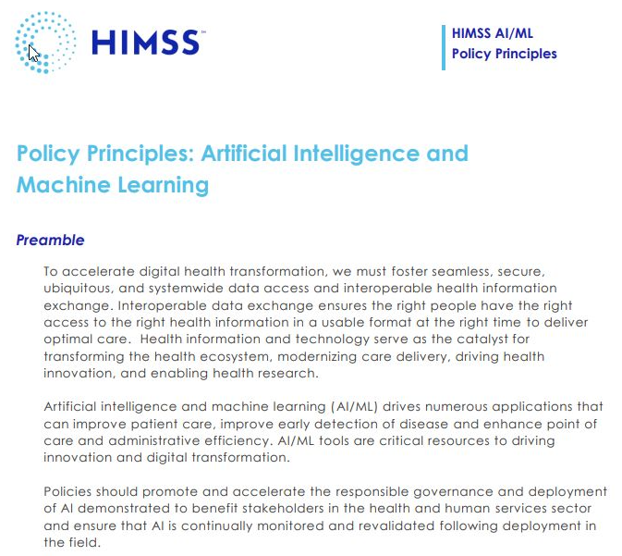
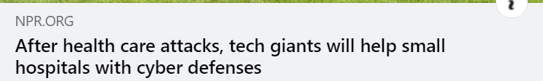
Advocacy:
Grassroots to Grass Tops
The Content MegaTeam
Why Advocate?
Partnership with Chapters
Election 2024
Taking Action

Slide 6
GR & Informatics Team Matrix
Open Position
Sr. Director Informatics & HIT Standards
Emely Lemus
Informatics Specialist
Rob Havasy
Sr. Director Informatics Strategy
Jonathan French
Sr. Public Policy and Content Development Director
Tammy Kwiatkoski
Sr. Director Informatics Operations & Implementation
Lee Kim
Sr. Principal Cybersecurity
& Privacy
Whende Carroll
Clinical Informatics Advisor
Mike Kroll
Sr. Informatics & Operations Manager
Kelly Liput
Information Specialist
Sarah Bell
Sr. Informatics Specialist
Christina Caraballo
Vice President Informatics
Tom Leary
Sr. Vice President & Head of Government Relations
Eli Fleet
Sr. Government Relations Director
Valerie Rogers
Sr. Government Relations Director
Evan Dunne
Sr. Government Relations Specialist
Mike Benol
Government Relations Director
Marisela Moreno
Sr. Program Manager (IIP)
David Gray
Government Relations Director
Open GR Position
Manager
Open Informatics Position
Alana Lerer
Sr. Government Relations Manager
Cait Obenauf
Program Manager
Gwynne Jelbaoui
Program Manager
Color Key
Operations
Strategic Advisory
Health IT Standards & Cyber
Clinical
Content Development
Relationship Management
*Solid Box = Lead
*Star = Matrix Foci
Notes:
Operating procedures
Prinary function is not committee – give a portfolio – portfolio management with qustions how the portfolio would work – is cait with jonathan and how to get to the Tom Doodle.

Slide 7
MegaTeam Responsibilities to Our Members
Provide Content and SME engagement to the HIMSS Enterprise
Create content and resources to inform, drive action, and lead change

Slide 8
Creating and Publishing High-Impact Content
AI Global Public Policy Principles -- published
TEFCA eBook published: Understanding National Interoperability Frameworks and Networks
Whitepaper: Measuring Digital Health Equity for Impact – a Proposed Framework for Using Digital Determinants of Health to Measure the Impact of Digital Health Services
Comment submitted to US Government: Physician Fee Schedule
HIMSS Provides Comments in Response to CIRCIA Reporting Requirements
HIMSS-SIIM Enterprise Imaging Community 10-years of Collaboration: From Data to Diagnosis: Advancing Enterprise Imaging Through Key Trends and Innovations

Slide 9
Advocacy:
Grassroots to Grass Tops
The Content MegaTeam
Why Advocate?
Partnership with Chapters
Election 2024
Taking Action

Slide 10
Health Equity
Recurring Themes
Population and Public Health
Workforce Development
Interoperability
Connected
Health
Cybersecurity, Data Privacy
Artificial Intelligence
Policy Pillars
Make Communities Healthier
Increase Economic Opportunity
Expand Access to High Quality Care
Foundational Values
Support Global Health Transformation

Slide 11

2024 Key Policy Initiatives
Health Equity as a key driver for all policy development!
Telehealth and Connected Care flexibilities
Data Interoperability
Trusted Artificial Intelligence in Healthcare
Maternal Health – leveraging technology to reduce maternal mortality and eliminate disparities
Public Health Data Modernization
Confidential

Slide 12

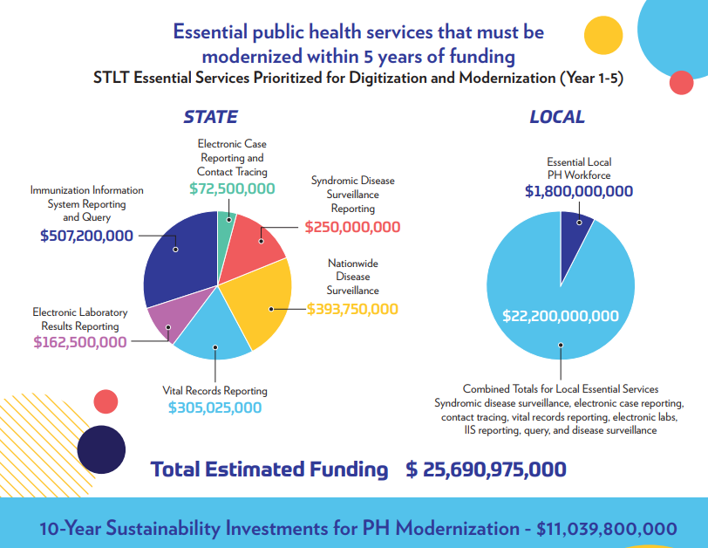
Fixing a Policy Gap!
Predates the Pandemic!
2009: Public Health – Not part of ARRA
Jan. 2019:Data Partners – Established
Measles Outbreak 2019; Data from 2015
160+ disparate systems in CDC;
Unknown problem in STLT Community
  Advocating for Change
  2021-2: HIMSS Report -- $36B need
  2020-23: $50M grows to $3B
  Sept. 2024: Just-in-Time Measles Data!!

Slide 13

Public Health Information and
Technology Infrastructure
Modernization Funding Report

Slide 14
Advocacy:
Grassroots to Grass Tops
The Content MegaTeam
Why Advocate?
Partnership with Chapters
Election 2024
Taking Action

Slide 15
Policy defines what you can do, and what you must do.
If you do not advocate, then those who define policy decide what you can and must do, without you.
"
"
"
"

Slide 16
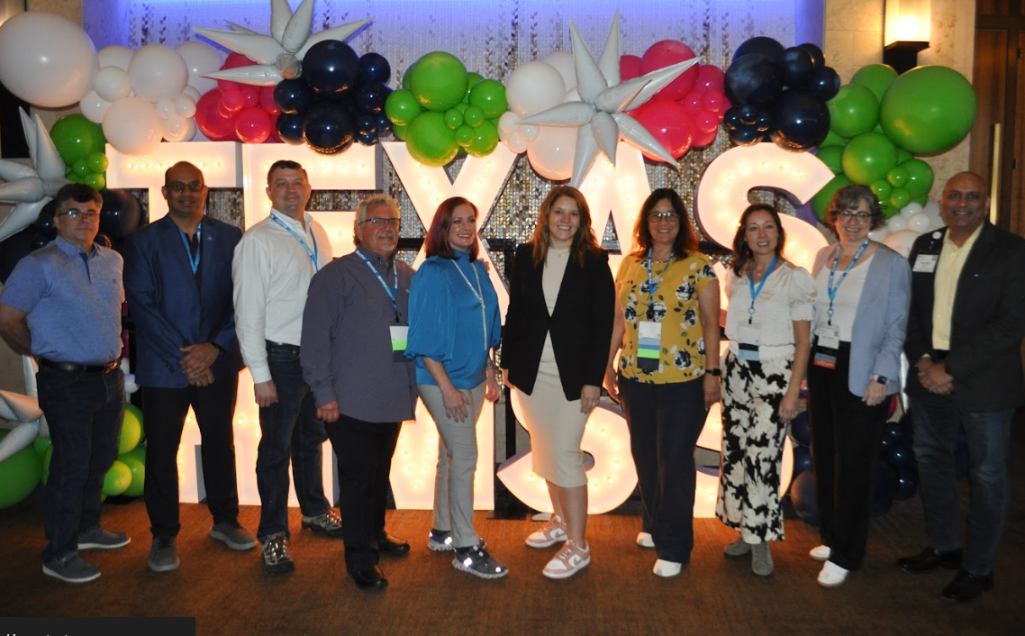
Engagement Strategies
Connect and organize visits with government and partners
  Legislative branch (State Senators and Representatives, Assemblymembers)
  Executive branch
  Non-profit partners
Highlight and recognize governmental efforts and officials
Host a chapter advocacy day, discussion, or event
Integrate advocacy/policy into all chapter initiatives
Write to your officials through HIMSS’s Legislative Action Center

Slide 17
Success Stories in the Making
HIMSS Health IT Roadmap
  Colorado, Georgia, Rhode Island
Advocacy Starter Fund
  Alabama
State and Provincial Officials
  British Columbia, California, Louisiana,
  Prairies, New Jersey, Florida, Washington,

Slide 18



HIMSS Chapter Advocacy Recognition
Central Texas
Colorado
Dallas-Fort Worth
Georgia
Greater Illinois
Houston
Michigan
National Capital Area
New England
Northern Ohio
Tennessee
South Florida
Alabama
Greater Illinois
Iowa
Canadian Prairies
Eastern Canada
Maryland

Slide 19
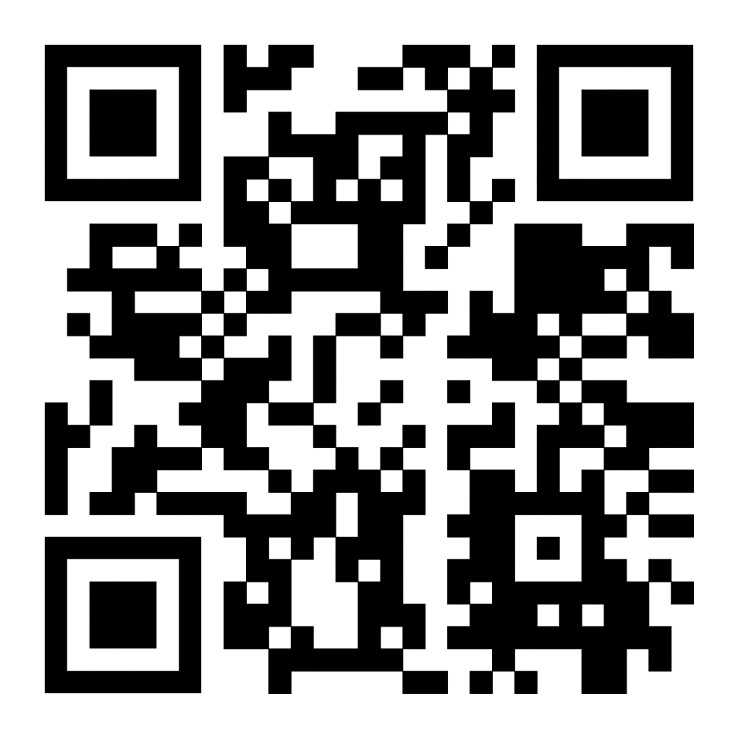
HIMSS Annual Call for Committee Members
Be part of the pulse to lead and execute HIMSS’s Strategic Initiatives!
Develop tools and resources with fellow health information and technology IT experts
Build a network of like-minded colleagues
Contribute to the global advancement of health and healthcare
Must be a HIMSS member for at least one year and qualifications specific to each committee
Applications: Open Sept 17th at 12:00pm CT through 11:59pm CT on Oct 1st
Notes:
HIMSS seeks health information and technology changemakers to help lead and execute HIMSS’s strategic initiatives
2 year term

Slide 20
Advocacy:
Grassroots to Grass Tops
The Content MegaTeam
Why Advocate?
Partnership with Chapters
Election 2024
Taking Action

Slide 21
Election 2024
U.S.: Presidential, Congressional, State, and Local Races
Digital Health Transformation is a borderless, and mostly non-partisan issue
Anticipate Harris or Trump Administration to continue the path of supporting digital health transformation; Approach for TEFCA, HIEs, QHINs, etc. may change.
Data privacy, access, cybersecurity, and AI are "on the ballot"

Slide 22
Advocacy:
Grassroots to Grass Tops
The Content MegaTeam
Why Advocate?
Partnership with Chapters
Election 2024
Taking Action

Slide 23

Time to Take Action
Telehealth; Critical Infrastructure; Health Equity; Maternal Health; Patient Identification
Notes:
Quorum call to action addition

Slide 24
Conversation
24

Slide 25
Advocate Workshop
Advocates: Head upstairs to Periwinkle-Verbena

Slide 26
Event Production Successes & Challenges
Artina Mitchell
Bert Hill
Brittany Royal-Killam
Washington
Moderator
Minnesota
Dallas-Fort Worth
Jeremiah Clark
Michael Wall
Northern Ohio
Michigan
Notes:
Northern Ohio HIMSS Chapter info:
Membership size: Approximately 1,500 registered members
Vast majority are "individual organizational affiliates"; our region has several large healthcare system as OAs that their employees join us through.
Committees:
Program (Events) Committee
Membership Committee
Sponsorsship Committee
Education
Communication
Advocacy
AI Initiative
Board Size: 18
Types of Events:
Two main in-person events per year, each being an all-day event (Spring and Fall, typically June and October)
Various webinars around various topics throughout the year.

Slide 27
Networking Break
Return at 11:00am

Slide 28
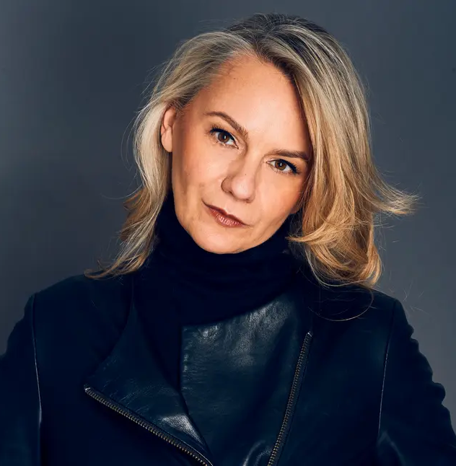
Marketing with Purpose
Crafting strategies that drive results
Christine Buck
Chief Marketing & Communications Officer, HIMSS

Slide 29
Vision
To realize the full health potential of every human, everywhere.
Mission
Reform the global health ecosystem through the power of information and technology.

Slide 30
Driving member-centric marketing that works

Slide 31

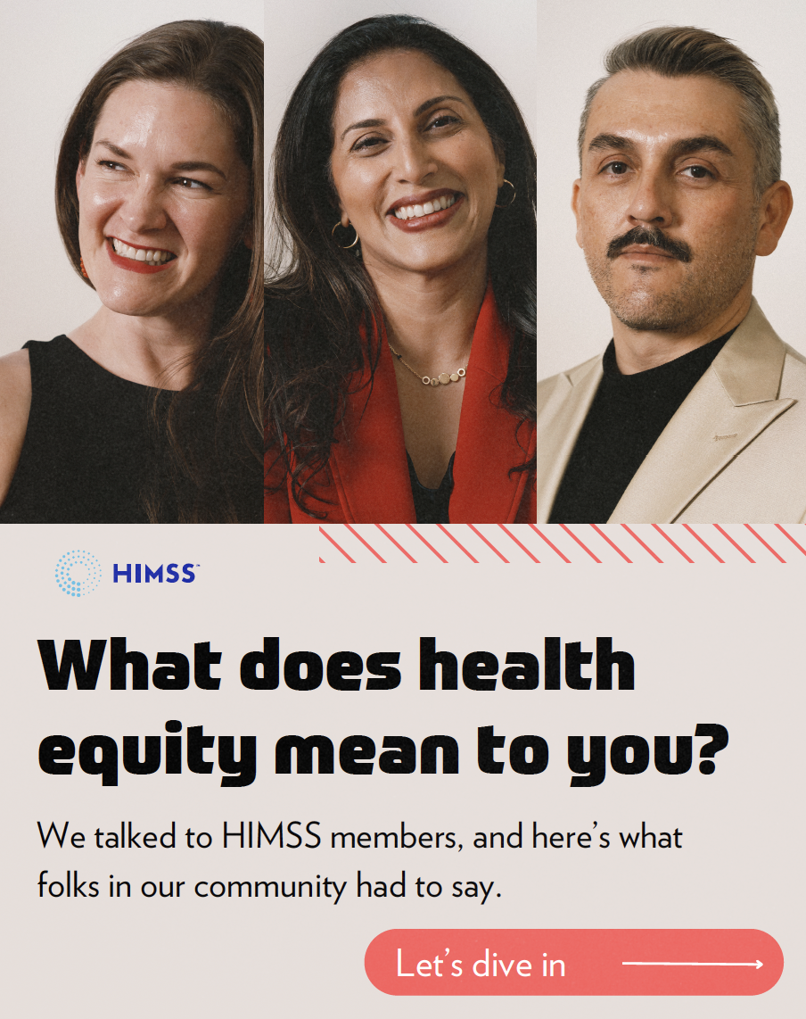
Why Member-Centric Marketing Matters
At HIMSS, the evolution of our marketing rests on messaging and visuals that center our members, creating a connective, multi-dimensional experience.
Membership will have its own look and feel, representative of neutral tones focused less on the brand and more on the member.
Campaigns will support:
Social media conversations
Paid ads and retargeting
Email nurture campaigns
Web experience and storytelling

Slide 32
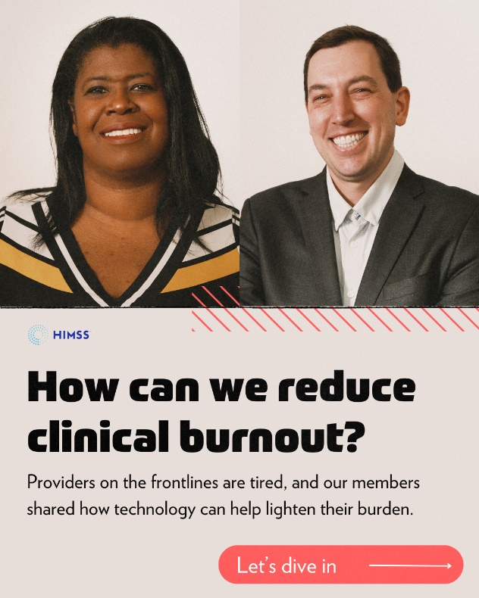
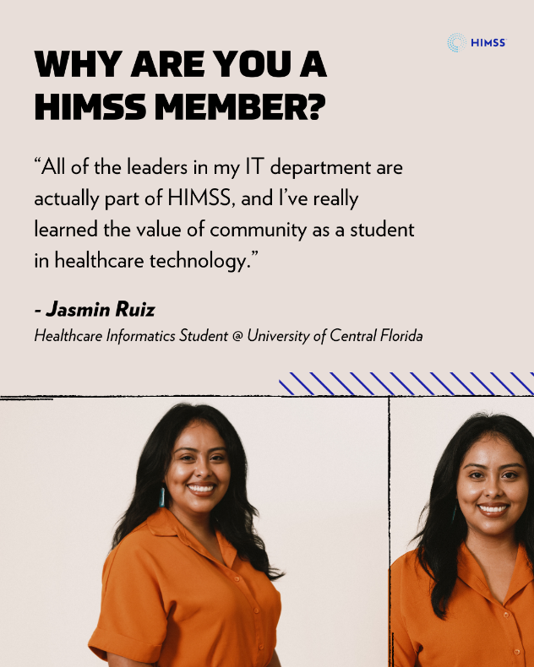
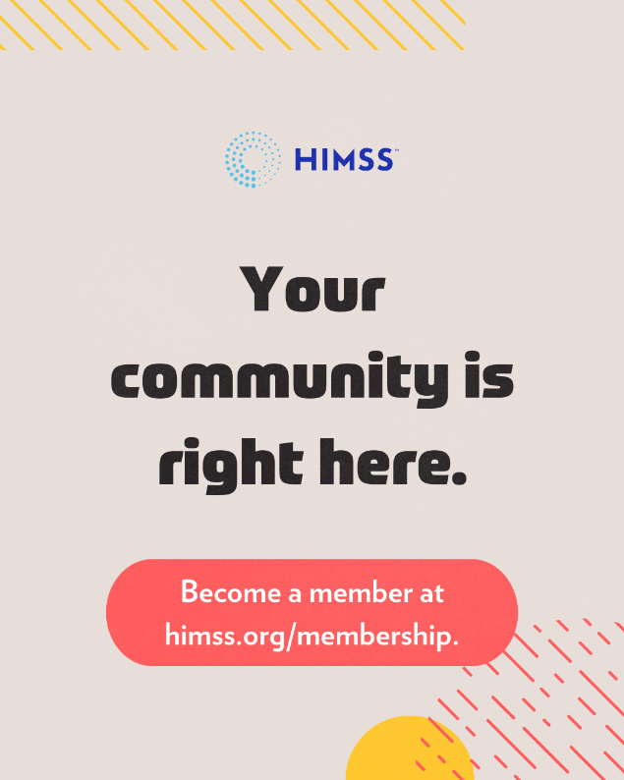
Putting Members First
Our marketing is designed to reflect the central role our members have in realizing the HIMSS mission and vision. When members are the focus, it personalizes your storytelling.

Slide 33
Your Member-first Marketing Strategy
Here are a few essential commandments to help you deliver a stronger marketing plan.
SET YOUR GOALS
DEFINE SEGMENTS
BUILD CHANNELS
CREATE CONTENT
Establish measurable and attainable goals and objectives for your programming.
Think about what you want
to accomplish. Engagement? Attendance? Member growth? Once this Is determined, you can
set your own goals.
Think at your audience needs
and consider evolving to segmentation.
The spray and pray approach
is not an effective tactic for email. You know your members well, so consider their needs via careful audience segments.
Diversify your marketing
by delivering across
effective channels.
Email is a very effective way to communicate but consider experimenting with YouTube and various social channels to generate engaging discussions.
Create targeted, high-quality content you know your audience
is looking for.
Make your member content connect and resonate through engaging site content and interactive experiences like interviews, video or infographics.

Slide 34
Best practices for email and social marketing

Slide 35
Focal Points for Marketing Engagement
1
Focus on your expertise and offering
Amplify content that centers your chapter as an expert by including events, training, awards or education.
2
Share relevant news and resources
Share new and exciting content on your site, in emails and across social media channels.
3
Amplify chapter member stories
Create content that spotlights the diverse stories of your chapter members.
4
Support important observances
If the observance is part of your chapter strategy, support via amplification, especially on social.
5
Highlight sponsored or partner events
Feature speakers and sponsors, and/or amplify events via marketing channels.

Slide 36
Social Dos and Don’ts
What you should do:
Closely check your grammar and spelling.
Prioritize networks based on relevance.
  We see the most engagement on LinkedIn.
Set aside 10 minutes to respond to comments daily.
Be consistent with posting and frequency.
  We recommend:
    LinkedIn: 1x
    X (formerly Twitter): 3-4x
    Facebook: 4-5x
    Instagram: 1-2x
    TikTok: 1-4x
Use exciting and engaging visuals.
  Images with faces increase clicks.
  Most algorithms prioritize video content.
  What you should avoid:
  Don’t over-post each day.
  Don't violate copyright laws by using images, videos, or other content without permission or proper licensing.
  Don't disclose private or potentially sensitive information.
  Don’t overuse hashtags.
    Hashtags should be 10 characters or less.
  Don't spam your followers with excessive promotional content.
  Don't neglect negative comments—use them as an opportunity to build credibility.

Slide 37
Email Dos and Don’ts
What you should do:
Keep a consistent font style and size.
Use relevant and energetic imagery.
Understand the power of subject lines:
  Make your intentions immediately clear.
  Keep subject lines under 50 characters.
  A/B test to find the most effective voice.
Choose meaningful metrics to measure success:
  Open rates should be above 20%.
  CTOR should be above 7%.
  Deliverability should be above 90%.
  Unsubscribe rates should be 0%.
Personalize your emails to enhance your connections with members.
  What you should avoid:
  Don’t over-send emails. You should send about one email a day, with a maximum of two to three deployments a week.
  Don’t violate email regulations: It’s essential to comply with CAN-SPAM, GDPR and other important laws.
  Don’t use words that are likely to send your emails to spam: Avoid words like buy, order, cash, free, price, cheap, earn, money, chance, miracle, sample, or diagnostic.
  Don’t lean on pitches. Take this opportunity to show your expertise In health information and technology as opposed to using gimmicky language.
  Don’t be long-winded: Keep emails brief and to the point by ensuring your message remains above the fold.

Slide 38
Sneak Peek
Where we’re headed

Slide 39
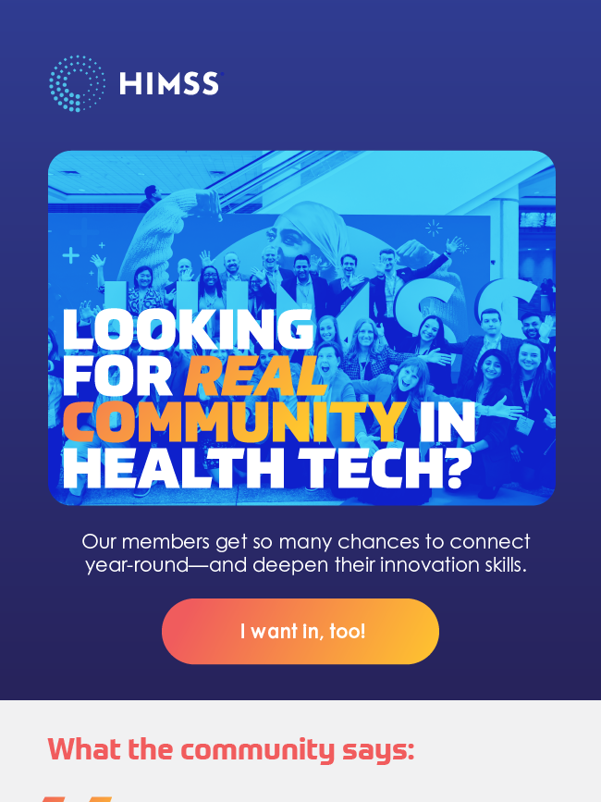
Email Marketing
We’ve focused on optimized, redesigned templates that deliver better experiences for our current and potential members.
*Highly confidential: DO NOT SHARE.
Notes:
Kristina Winters / James Burnett

Slide 40

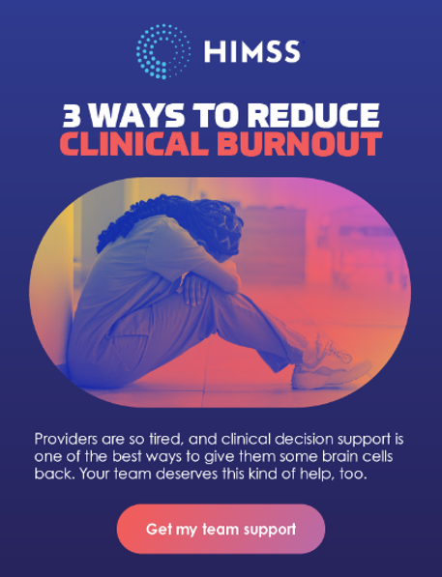
Throughout email, social and paid advertising, we are moving toward gradients and bold use of color.
*Highly confidential: DO NOT SHARE.

Slide 41
The Site
We’re delivering vibrant web and mobile experiences that are user-friendly, interactive and easy to navigate.
Notes:
Kristina Winters / James Burnett

Slide 42
Marketing Workshop

Slide 43
When to use the strategic plan on a page*
Use this template to succinctly communicate marketing strategy with stakeholders. The template can be duplicated to communicate more than one priority.
View the CLRA:
  For a more comprehensive marketing strategy template.
  To operationalize your marketing strategy, use an objectives and key results (OKRs) framework for goal setting.
  For a step-by-step guide to marketing strategic planning.
*Tools and resources for this workshop have been provided by Gartner.

Slide 44
Strategic Plan on a Page
Document key elements of your strategy. Examples are illustrative.
STATEMENT OF STRATEGY: To build market awareness and drive growth for HIMSS globally across our key business segments: Membership, Analytics, Global Events and Government Relations.
Current State
Measured by 4 to 7 metrics Determine the implications of the business strategy for the marketing function Diagnose any gaps in marketing’s current capabilities that must be addressed Determine relevant metrics that describe the as-is state that must be monitored to measure progress toward the target state Be sure the metrics can be easily and accurately measured with sufficient granularity so that they are actionable by decision-makers
Examples Percentage of consumers purchasing company products online: 35% Site traffic totals 25,000 visitors per month
Plan
Expressed as 1 sentence | Focus on succinctly communicating your objective Be specific about what you intend to accomplish Include how you intend to accomplish it at a high level
Example Drive the company’s top-line growth by building a preference for digital channels
Constituted of 4 to 7 initiatives | Focus on key results required to demonstrate progress toward your stated strategic objective Determine accountability within marketing or with other stakeholders Include as much specificity as possible with regards to measurement and timing
Examples Improve online customer experience by enhancing digital product catalog to enable 65% of consumers to purchase online by year-end Invest in digital advertising to drive 50,000 visitors per month to the website within 6 months
Rationalized by 4 to 7 assumptions | Articulate risks to plan including external, environmental factors and internal dependencies | Articulate risks to plan including external, environmental factors and internal dependencies
Example Digital product assets will be standardized by mid-year
Future State
Measured by 4 to 7 targets Describe the organization’s desired future state Set goals to determine when the future state will be reached Your future state should not be so distant from the current state that you are unable to measure progress toward it Your future state does not have to be your end goal; it may reflect progress toward more ambitious, long-term goals
Examples Percentage of consumers purchasing the company products online: 65% by year-end Site traffic: 50,000 visitors per month within 6 months

Slide 45
Strategic Plan on a Page
STATEMENT OF STRATEGY: To build market awareness and drive growth for HIMSS globally across our key business segments: Membership, Analytics, Global Events and Government Relations.
Plan
Current State
Measured by 4 to 7 metrics
Plan
Expressed as 1 sentence
Constituted of 4 to 7 initiatives
Rationalized by 4 to 7 assumptions
KPIs
Measured by 4 to 7 targets

Slide 46

Thank you!
Christine Buck cbuck@himss.org

Slide 47
Useful Resources

Slide 48
Additional Resources
Email marketing guidance:
Improving your email subject lines | Hubspot
Trigger words that push emails to spam | Hubspot
Email metrics you should track | Hubspot
Social media guidance:
How often should you post?| Sprout Social
When are the best times to post?| Sprout Social
Social metrics to consider | Sprout Social
Video
Simple guidelines for filming | LinkedIn

Slide 49
Managing an Effective Chapter Board
Lorna Waggoner
Howard Rosen
Sepi Browning
Iowa
Moderator
Eastern Canada
Georgia

Slide 50

HIMSS25 GC CHAPTER OPPORTUNITIES

Slide 51


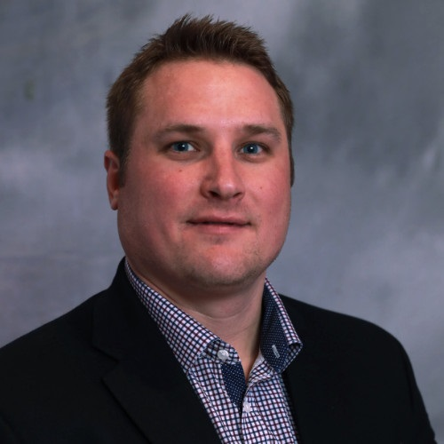
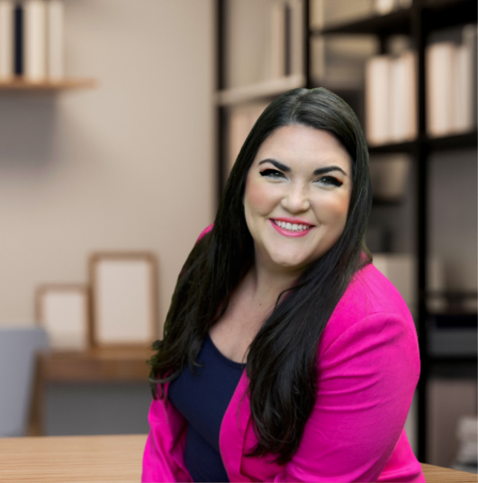
Lee Marana
Health IT Content Director
Informa Markets
Lauren Whittington
Head of Marketing
Informa Markets
Notes:
Welcome to the HIMSS25 Strategy summit.
This is not an existential question…it’s real. Why are we all here? Why do we do what we do?
We’re all in the business of helping people and more importantly helping the people that help people.
The products and services you create help change lives…. Help save lives and that’s why we within the marketing team at HIMSS are focusing on getting the biggest and best audience to HIMSS25 that you’ve ever see because this is where we help to create tomorrow’s health

Slide 52
WHAT’S NEW FOR HIMSS25
REVISED CONFERENCE SCHEDULE
TECHNOLOGY FOR ENHANCED ATTENDEE EXPERIENCE
EXPANDED TOPIC
AREAS
MORE CURATED EXPERIENCES
GREATER
SUSTAINABILITY
AMPLIFIED MARKETING EFFORTS
Notes:
For HIMSS25 we’ll use different elements of the marketing mix to influence and meet the needs of our target customers in the most effective and efficient way possible
Optimizing our multichannel approach to reach the right person with the right message at the right time

Slide 53




Notes:
And here is how our personas will come to life in our enhanced look and feel for 2025
Persona Focused
Vibrant Colors
Fun and adaptable design elements to provide movement
This modernizes our marketing and pulls in professional attendees
Who care
We’ll focus on the people you want to meet

Slide 54
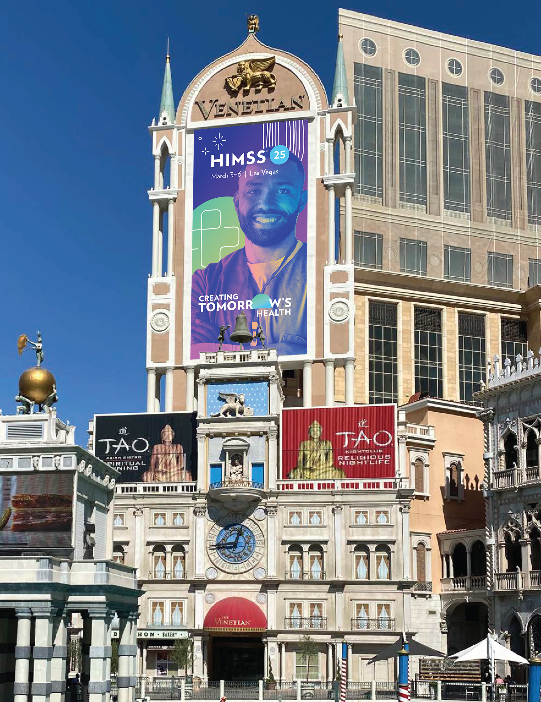
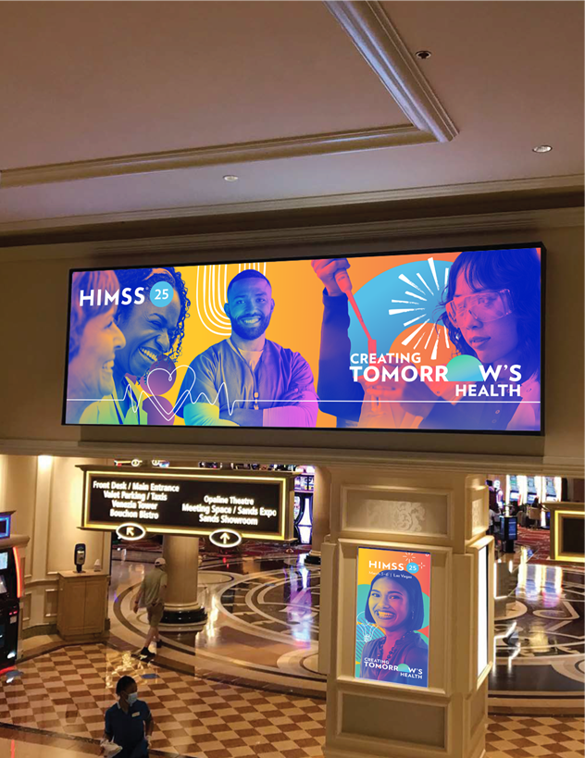
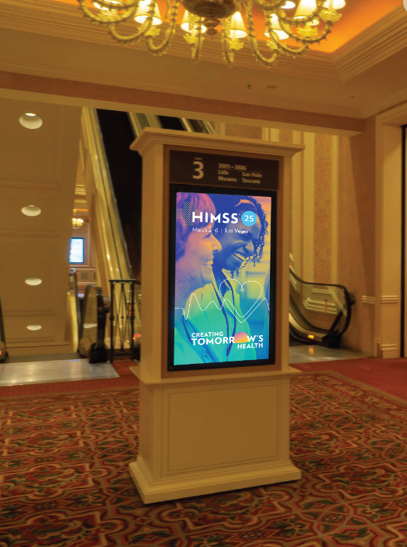
Notes:
And make their way to the venitian, inside the lobby as they’re making their way to your booth.

Slide 55
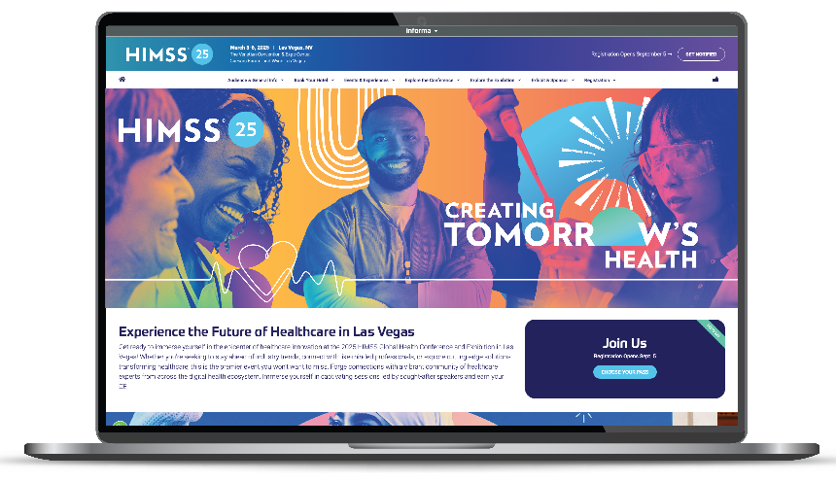
www.himssconference.com
Notes:
And in addition to a new look and feel to surprise and delight our attendees and exhibitors, we have new enhanced experiences.
New Website – Have you checked it out?
New email templates – Get ready for some awesome announcements
New enhanced digital signage onsite to drive attendees onto the showfloor and to your booth
We’re working with a new video production company
And copywriters

Slide 56








CHAPTER OPPORTUNITIES
Notes:
Let’s go on a journey together of what attendees will see before they arrive at your booth

Slide 57
CHAPTER INCENTIVES
1. HIMSS GC Registration Discounts
  Chapter Leaders: 10% ($99) discount off the registration fee through February 10, 2025.
  Chapter Members: 10% ($99) discount off the early bird registration fee. Discount will be offered starting September 15 – October 31, 2024.
  Discount codes will be provided.
2. HIMSS Chapters Registration Incentive
  Chapters will receive a one-time payment of $3,500 to be paid post-event OR 5% of their Chapter’s registration sales (whichever is larger) once a Chapter has registered 8% of their total Chapter for HIMSS GC.
3. Voice of a Chapter Member at Keynote
  One individual from six chapters to be selected to share 30 seconds, on stage collectively and one at a time with a spotlight, the value they receive from participating in a Chapter/Communities/Committees
Notes:
And in addition to a new look and feel to surprise and delight our attendees and exhibitors, we have new enhanced experiences.
New Website – Have you checked it out?
New email templates – Get ready for some awesome announcements
New enhanced digital signage onsite to drive attendees onto the showfloor and to your booth
We’re working with a new video production company
And copywriters

Slide 58
CHAPTER INCENTIVES
4. The Call for Best of the Best Chapter Encore Content will be as follows:
  Submission Timeframe is Oct 1 – Oct 31, 2024, through a simplified survey link
  Winners will be announced on November 8, 2024
  Winners will receive an official invitation to present at HIMSS25.
5. HIMSS Chapter, Communities, Committees Open House
  Scheduled before the Opening Reception in/near the Opening Reception
  Invite Representatives to host a table and celebrate their Chapter/Communities/Committees
    One 6’ draped table and 2 side chairs to be provided by the HIMSS Global Conference
6. Refer a Colleague
  When referrals are initiated, the referring individual will be entered into a contest where one winner will receive a free hotel room (at the Venetian or Palazzo) for up to 4 nights during the 2025 HIMSS Global Health Conference and Exhibition.
7. Complimentary Meeting Room:
  Chapters receive a complimentary meeting room to hold a board meeting during HIMSS GC. Chapters to email the HIMSS Chapter team with this request. Deadline: January 10, 2025.
Notes:
And in addition to a new look and feel to surprise and delight our attendees and exhibitors, we have new enhanced experiences.
New Website – Have you checked it out?
New email templates – Get ready for some awesome announcements
New enhanced digital signage onsite to drive attendees onto the showfloor and to your booth
We’re working with a new video production company
And copywriters

Slide 59
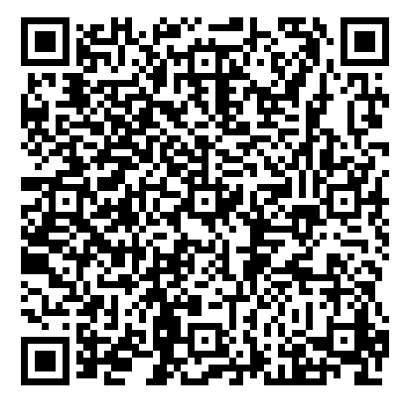
SURVEY TIME - FEEDBACK WELCOMED
  Please take a moment to answer these 3 questions, so we can understand how we can better serve you.
Notes:
And in addition to a new look and feel to surprise and delight our attendees and exhibitors, we have new enhanced experiences.
New Website – Have you checked it out?
New email templates – Get ready for some awesome announcements
New enhanced digital signage onsite to drive attendees onto the showfloor and to your booth
We’re working with a new video production company
And copywriters

Slide 60

Questions?
Questions regarding chapter opportunities, please reach out to chapters@himss.org
Questions regarding “Best of the Best” Encore Sessions, please reach out to Lee Marana at lee.marana@informa.com.
More information: himssconference.com
60

Slide 61
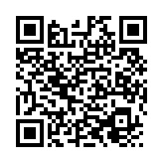
Thank you!
Grab-and-Go Lunch
All resources available on CLRA
Safe travels! See you in Las Vegas!
Please take the 2 question CLE evaluation

